Slide 1

Fibonacci sequence generation in VNMSim
Team members: Nikita, Kevin, Illia

Slide 2
Our chosen challenge
What is Fibonacci?
Why Fibonacci?
The Fibonacci sequence is a sequence of numbers that begins with 0 and 1. To get the next term simply add the two numbers before it.
The sequence is well known as the simple sequence appears in many places in nature and computer science.
Lots of Computer Science concepts use Fibonacci.
It appears in real data structures, such as AVL trees and Euclid’s algorithm.
It helps us connect math and computing.

Slide 3
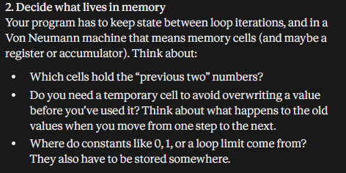
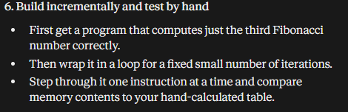
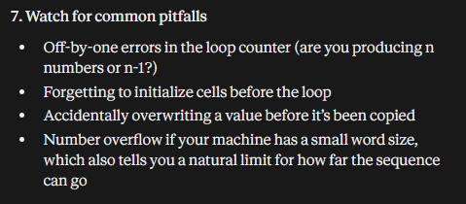
LLM Co-Development
Thanks to these answers the LLM gave us, we were able to shape our solution more correctly.

Slide 4
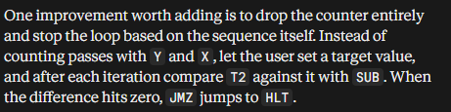

LLM Co-Development
Helpful suggestion
Problematic suggestion

Slide 5


Code walkthrough
Loop sequence
Values

Slide 6
Live Demo

Slide 7
Reflection
Co-Developing with LLM helped us shape our code more correctly thanks to the LLM’s helpful suggestions.
Sometimes, the LLM gave problematic suggestions that we had trouble understanding or even implementing.
Overall, co-developing with LLM can help you, but also mislead you at the same time with its suggestions.

Slide 8
Questions?

Slide 9
Thank you for listening

